Slide 1

Regional Sales Summary
Notes:
Overview of sales performance across U.S. regions, channels, products, and time.
Updated with 2017 budget vs actuals for added financial context.

Slide 2

Problem Statement
Sales teams often lack a clear, data-driven understanding of regional performance, making it difficult to identify growth opportunities and optimize resources.
This project aims to analyse and visualize regional sales data to uncover trends, evaluate profitability, and support strategic decision-making.

Slide 3

Approach
Integrate Sales Orders, Customers, Regions, Products, and Budgets
Clean & model the data; define KPIs (Revenue, Profit, Margin)
Run EDA on regions, channels, products, and seasonality
Deliver insights and actionable recommendations

Slide 4

Data Overview
Sales Orders (fact): order dates, channels, regions, products
Regions & State Regions: map city/state to U.S. region (West/South/Midwest/Northeast)
Products: product catalogue (SKUs)
Coverage: 5 years (2014–2018)

Slide 5

Project Workflow
1) Prepare & join datasets
2) Compute KPIs (Revenue, Profit, Margin %)
3) EDA: trends, seasonality, top SKUs, channels
4) Synthesize insights
5) Recommend growth actions

Slide 6
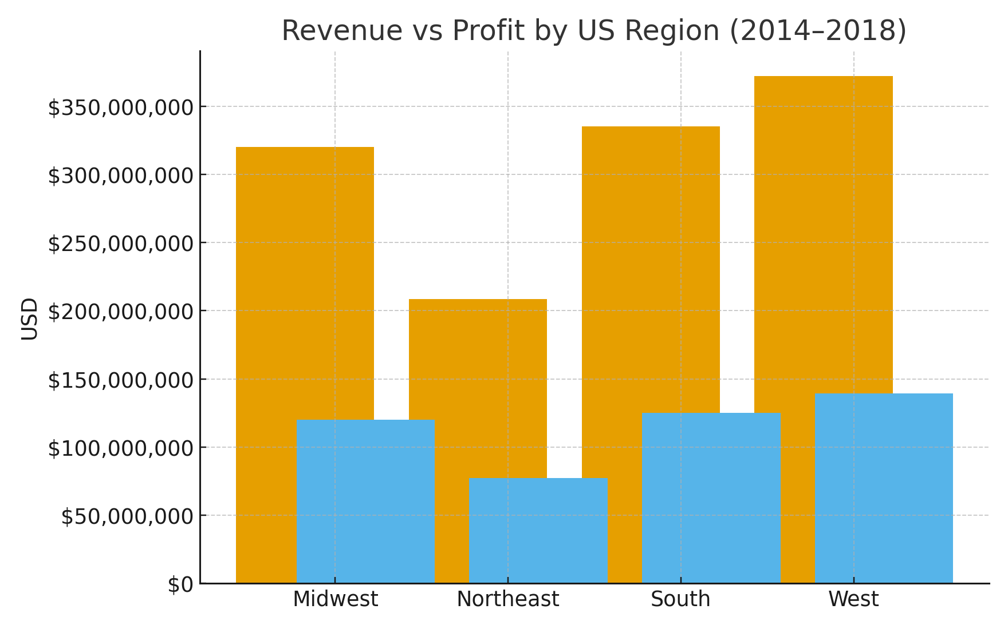
Revenue vs Profit by US Region
Notes:
Shows total revenue and profit (2014–2018) by region.
Highlights which regions drive the most volume and where margins are strongest/weakest.

Slide 7
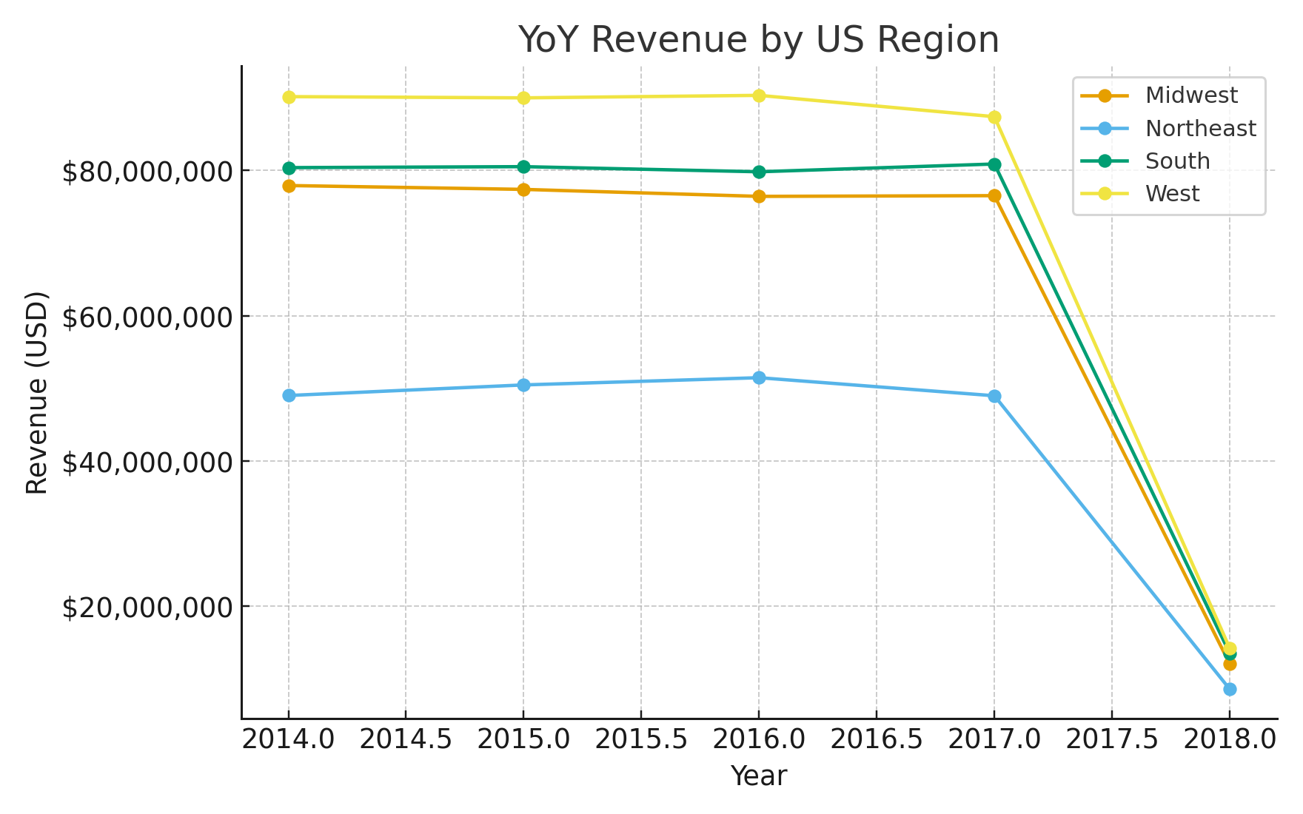
YoY Revenue by US Region
Notes:
Tracks revenue growth trends per region year-over-year.
Useful to spot regions with consistent growth versus those that stagnate or decline.

Slide 8
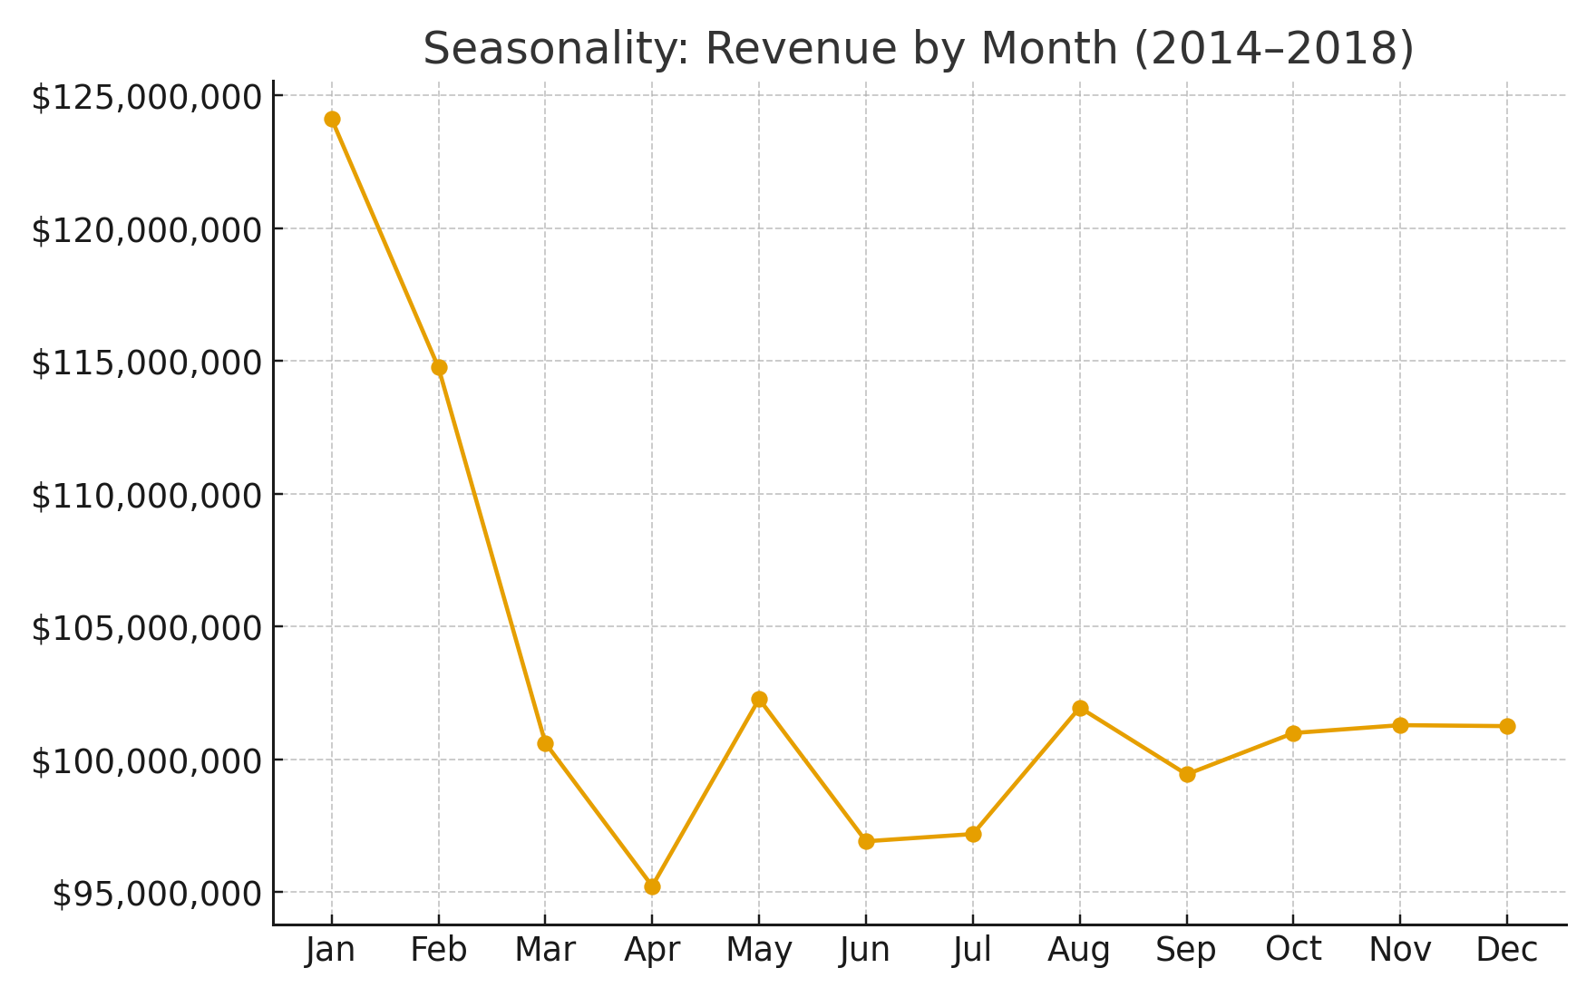
Seasonality: Revenue by Month
Notes:
Aggregates monthly revenue across years.
Clear peaks in late Q4 (holiday season) and dips in early Q1.

Slide 9
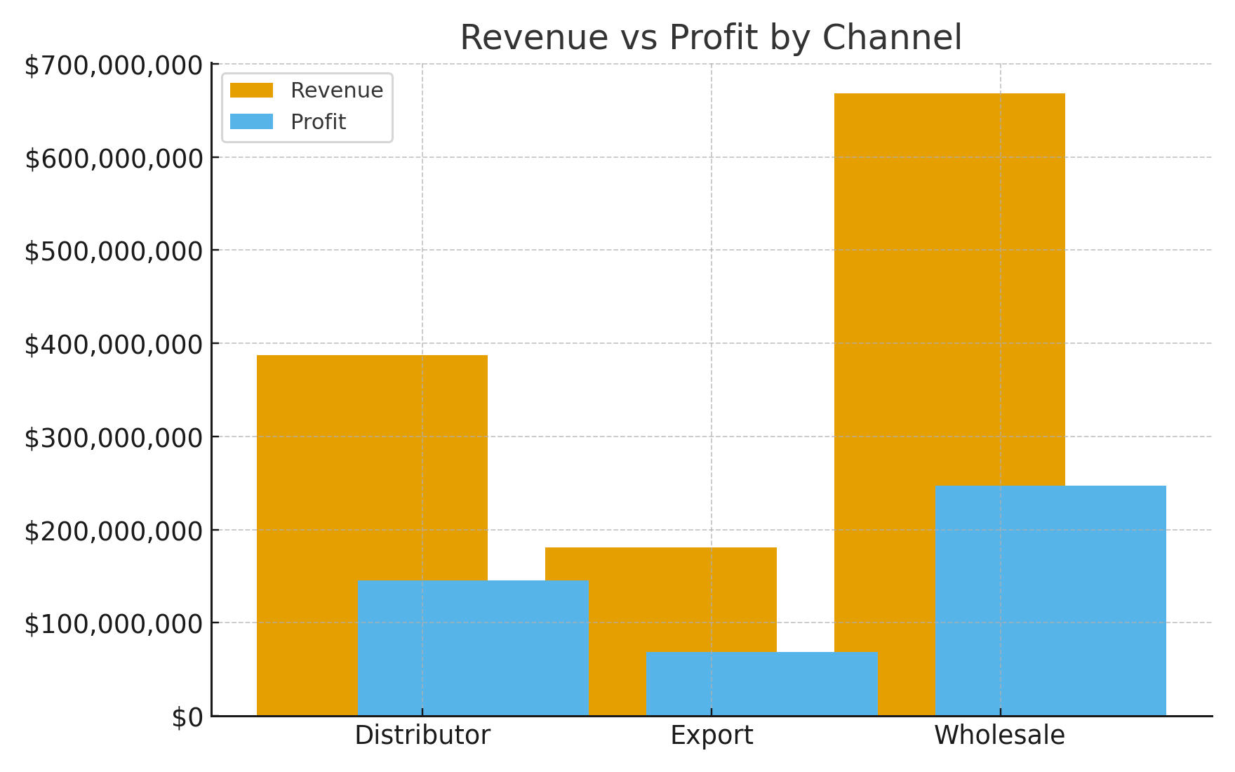
Revenue vs Profit by Channel
Notes:
Compares channels (Wholesale, Distributor, Export) on revenue vs profit.
Distributor channel has stronger profitability; Wholesale drives volume but at lower margins.

Slide 10
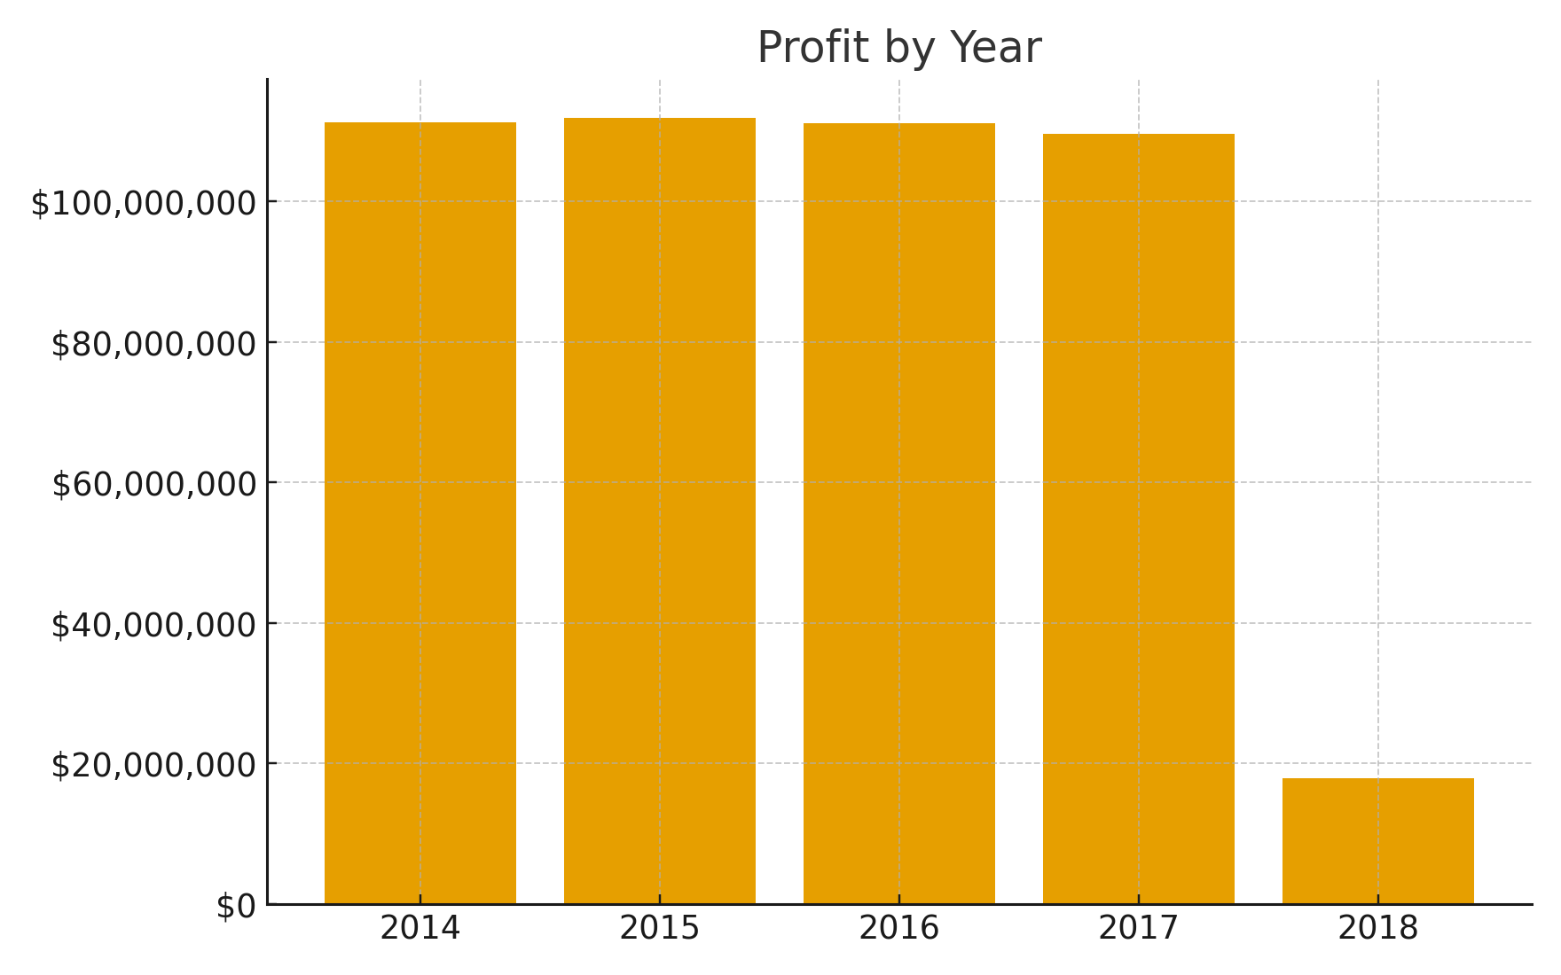
Profit by Year
Notes:
Total annual profit over the 5-year period.
Shows steady upward trajectory with peak profitability after 2016.

Slide 11
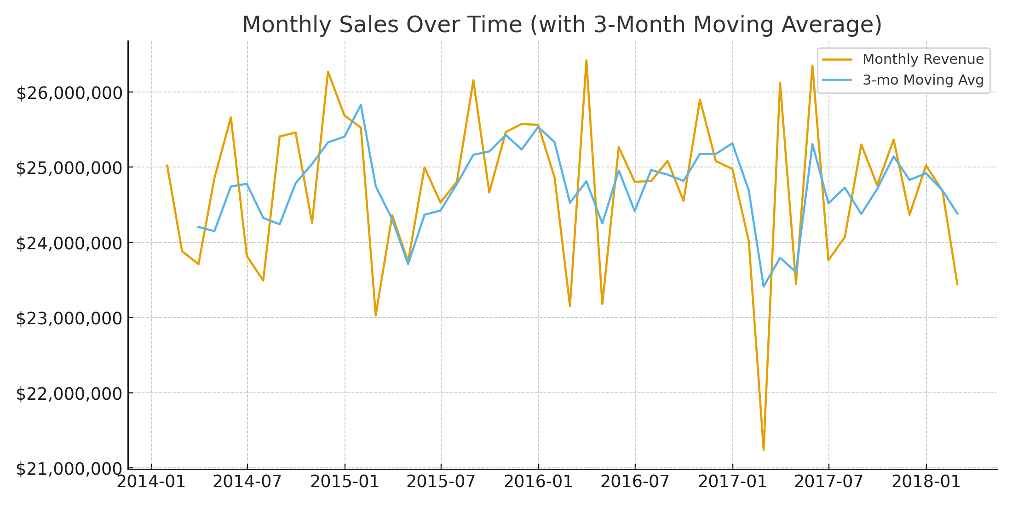
Monthly Sales Over Time (with 3-Month MA)
Notes:
Monthly revenue plotted as a time series, smoothed with 3-month moving average.
Captures seasonality but also the underlying growth trend.

Slide 12
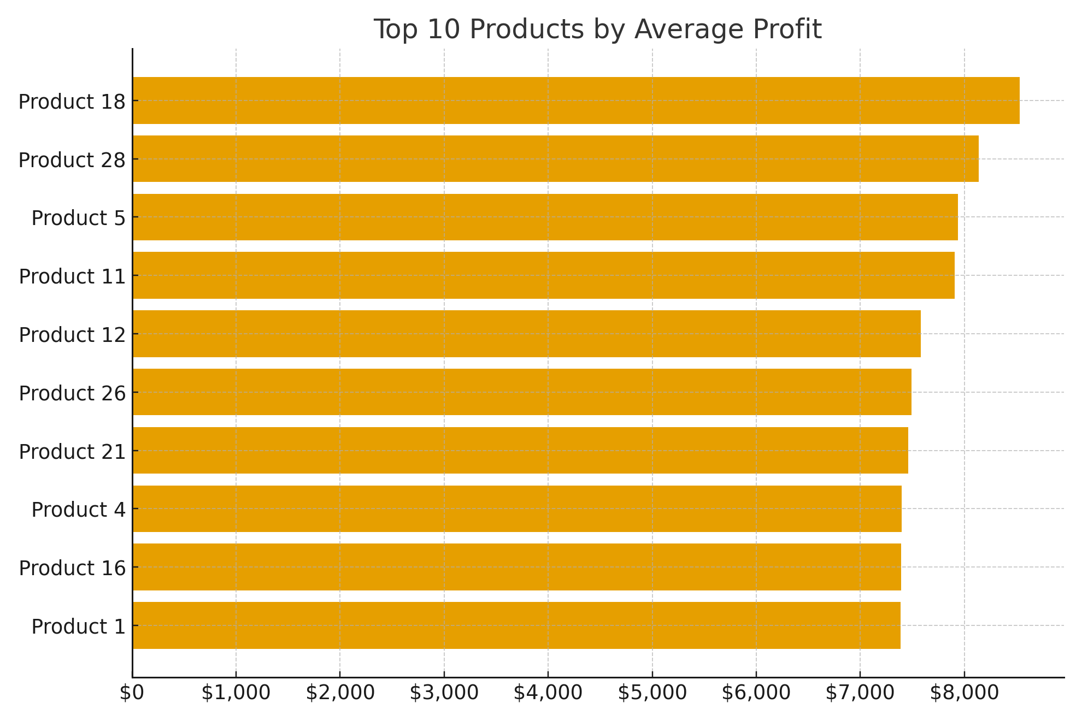
Top 10 Products by Average Profit
Notes:
Identifies SKUs with highest average profit per order.
Shows potential for premium positioning or targeted promotions.

Slide 13
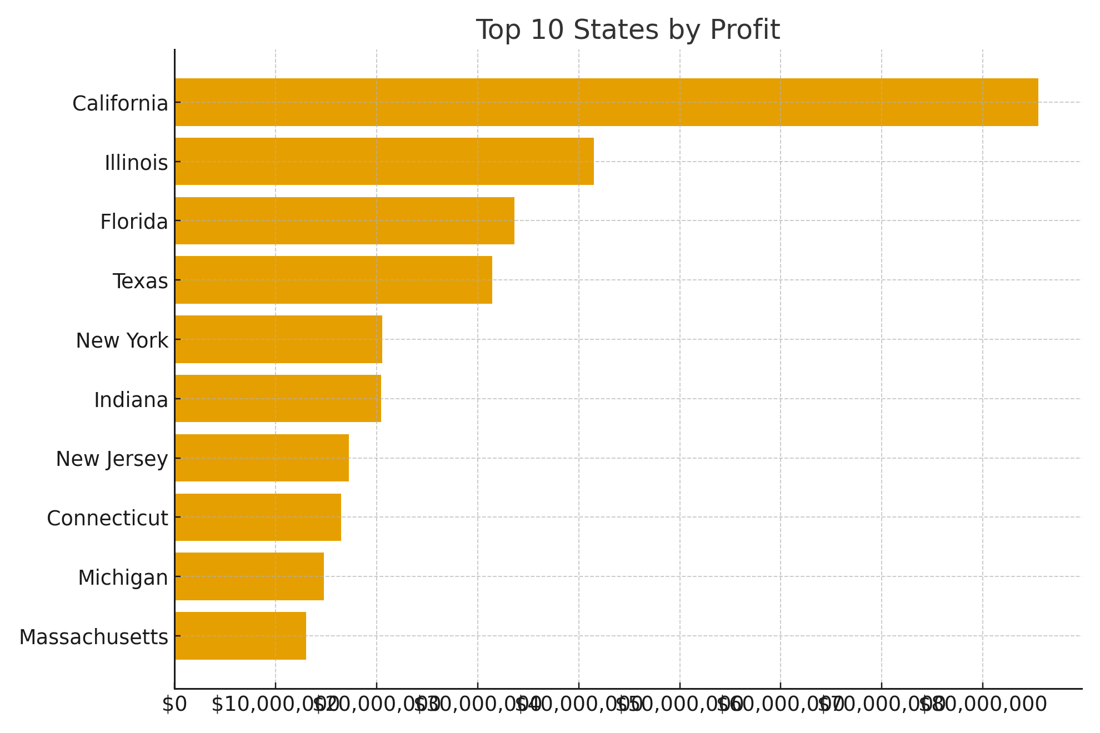
Top 10 States by Profit
Notes:
Highlights states contributing most profit across the 5-year span.
Profit concentrated in large economic centres (e.g., CA, TX, NY).

Slide 14
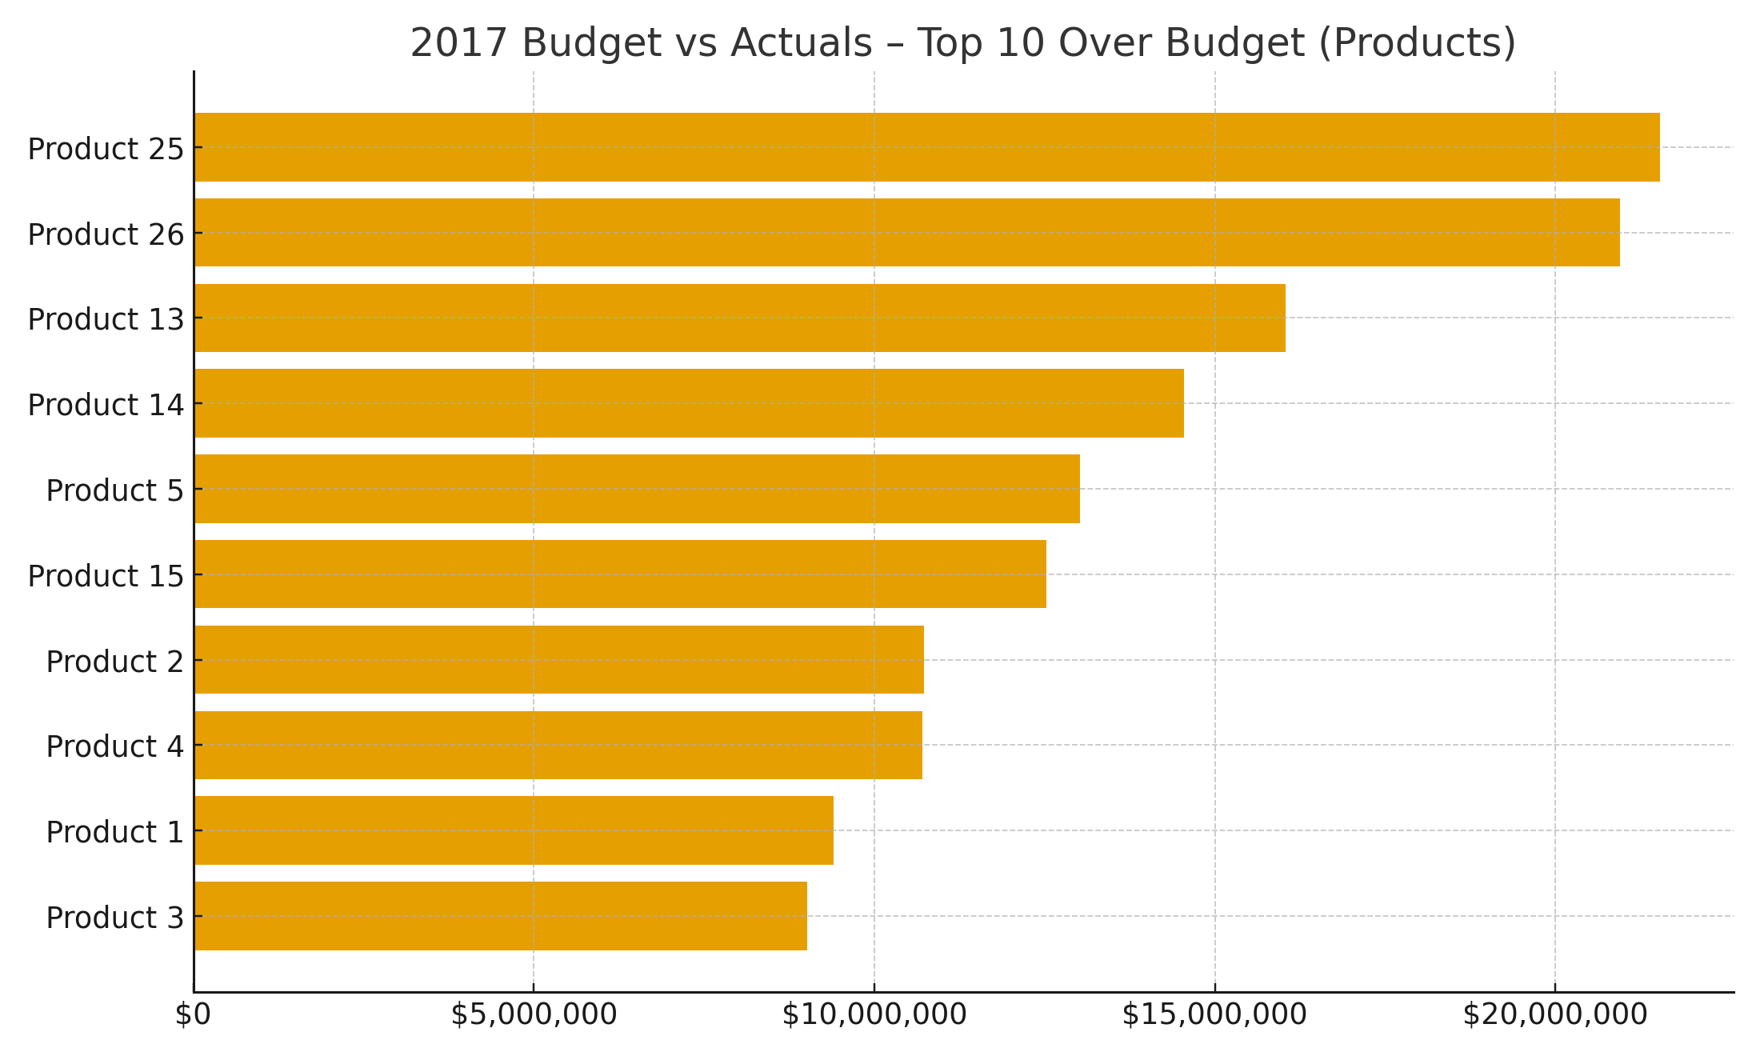
2017 Budget vs Actuals – Top 10 Over Budget (Products)
Notes:
Products that exceeded 2017 budget revenue by the largest margins.
Indicates strong performers to double down on.

Slide 15
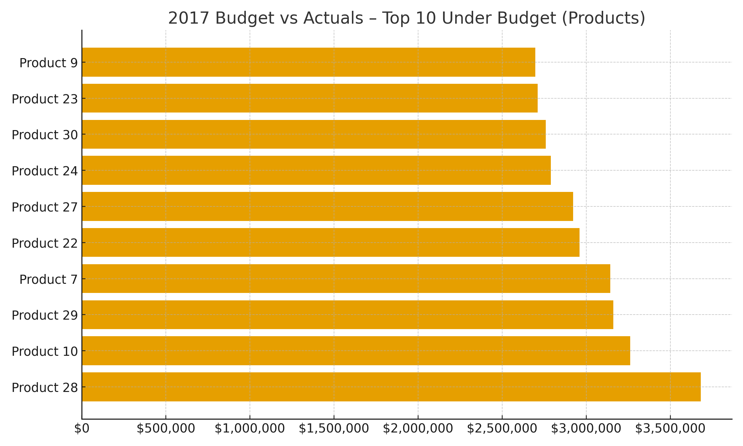
2017 Budget vs Actuals – Top 10 Under Budget (Products)
Notes:
Products that fell short of 2017 budget revenue targets.
Signals areas needing review (pricing, availability, demand planning).

Slide 16
Key Insights
West generated the highest revenue overall, while Northeast had the weakest margin profile.
Profit trended upward across 2014 -2018, peaking in 2015.
The Export channel consistently delivers the best margins - opportunity to scale or prioritise.
California is the most profitable state; performance is concentrated geographically.
Product 18 leads on average profit per order -supports premium positioning and targeted bundling.
Notes:
Summarises main findings: best regions, weakest margins, top channels, seasonality, product and state concentration.
Provides quick reference for decision-makers.

Slide 17
Recommendations
Focus more effort on the South, where sales and profits are strongest.
1
Look into pricing and costs in the West to see why profits are weaker.
2
Put more energy into growing the Distributor channel, as it brings in the best profits.
3
Plan stock, staff, and marketing to make the most of the busy run-up to Christmas (Nov - Dec).
4
Run special offers and promotions in Feb - Mar to help boost sales during the quieter months.
5
Adjust prices on popular products during peak seasons to get the best return.
6
Strengthen presence in California, Texas, and New York with local marketing and supply plans.
7
Choose 2-3 middle-sized states with good potential but lower current profits, and test ways to grow there.
8
Notes:
Suggested actions: prioritise high-margin regions/channels, align to seasonal demand, scale winning products, fix underperformers.
Roadmap for optimising sales strategy moving forward.

